Slide 1
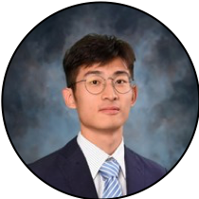


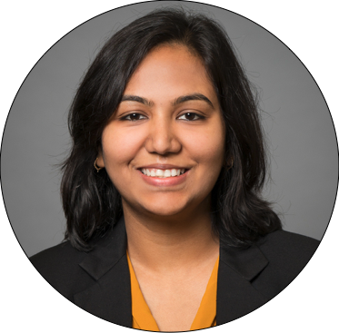
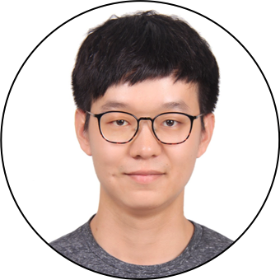

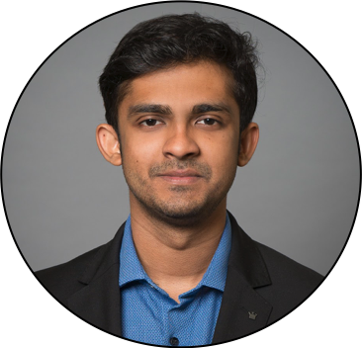
Cornell Tech & Samsung
Team BlueMoon
Jiacheng Dong
ORIE
James Chen
ORIE
Christian Rodriguez
CS
Mansi Garg
MBA
Harry Li
ORIE
Frans Fourie
ECE
Alan Abraham
MBA

Slide 2
How might we improve the cooking experience?
Notes:
Alan - Add content
Talk about pivoting, and what we learnt from this experience, how we tried our best to keep our spirits up!
Then about the benefits of cooking at home -- according to Harvard Health - The more you cook, the healthier you live.

Slide 3
Samsung Fridge Assistant
Help save time, stay healthy and create an environmental impact.
Computer vision, data science, and a pinch* of AI.
A recipe recommendation system that makes your fridge smarter and allows you to experience culinary arts with just a few taps.
*no pun intended
Notes:
Alan - Add content
Cooking is easier than people think. It can drastically improve your health and is more fun and cheaper than eating out. And no matter your ability, anyone can learn to do it.
We want people to get into the habit of cooking and ask themselves why I haven’t been doing this my entire life??
A smart that peeks inwards and suggests delicious and nutritious recipes based on available items.

Slide 4
Value Proposition
Supports multiple profiles
Recipe optimization
Meal planning efficiency
Reduce food wastage
Notes:
To customer
Access to what and quantity of everything you have in your fridge
Find recipes matching your fridge content
Help reduce food wastage

Slide 5
Why it makes strategic sense
Smart Refrigerator Market Expected to Reach $ 1 B by 2020
Growing at a CAGR of 17.70%
Samsung market share - approx 23%
Estimated Annual Revenue for existing recipe recommending apps = $100M
Notes:
Add value to existing Samsung product by adding program to product
Increase product value without increasing manufacturing cost
Unique feature give edge over competitors

Slide 6

Meet Samantha
Pain Points
I want combined recommendations for me and my son Jackson, who's allergic to peanuts.
I generally plan a week before to budget my groceries
I would like to avoid food wastage but I keep forgetting about items
Female
36 years old
Software Engineer
Lives in New York
Notes:
Fj and Alan - add content

Slide 7
SAMSUNG FRIDGE ASSISTANT
Notes:
Add content - Mansi & Alan
Link to demo

Slide 8



Technical Progress
Recipe Data
Fridge Stock
Expiration dates
*Previous Choices
*Quantity
Nutrition
Difficulty
*To do by next sprint
Notes:
Harry James Christian - add content
Recipe data from Genius Kitchen #(messy data cleaning, noisy data dumping)/ create recipe database
Created Recommendation System
Preprocess system input
Filtering (available ingredients) filter based on user preference and fridge stock
Ranking (freshness, user preference) rank higher for recipe that could use the food that soon expired
Future
Taking consideration of the quantity of ingredients needed
ML Personalized recommendations
Dong

Slide 9
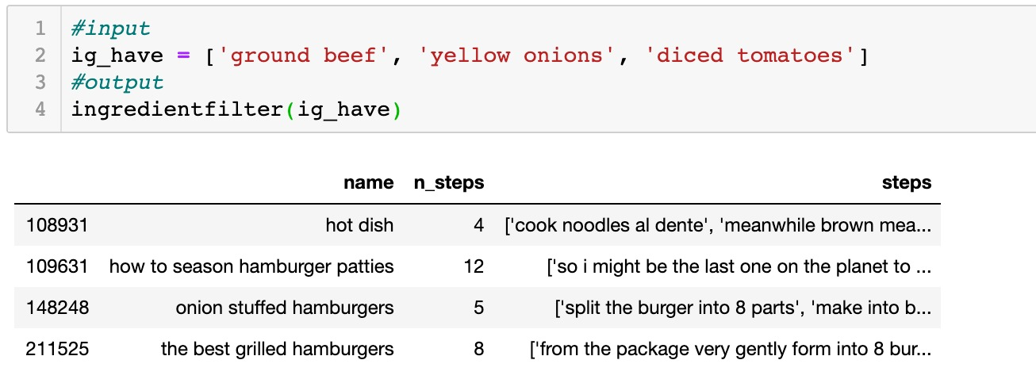
Technical Progress

Slide 10
Next steps
March 27
April 10
April 17
April 24
Near Future
Company advisor feedback collection
Experiment feedback accommodation
Technical challenge integration
Sprint 3
COVID 19 Gone
Feature Specialization (NLP input preprocessing, Recipe recommending))
Feature modification
Recommendation logic modification
Fully connected Front end and Back end
More robust recommendation system
Refined MVP ready
No more social distancing
Notes:
Dong and Alan - Add content
Featrue speicalization to differentiate our product from the market
Modifiy Reccomadation logic to accomodate user pain points
Connect front end back end, develop more robust reccomendation

Slide 11
Thank you

Slide 12
Appendix

Slide 13
Survey Summary
Most people cook multiple times a week
Most people just cook for themselves or at most one other person
People generally know better what they have in their fridges than the quantity of the items
People usually select recipes based on what they have in their fridges
Almost all people have food wastage due to forgetting about items
Generally people decide what to cook the day of
Notes:
Fj and Alan - add content

Slide 14
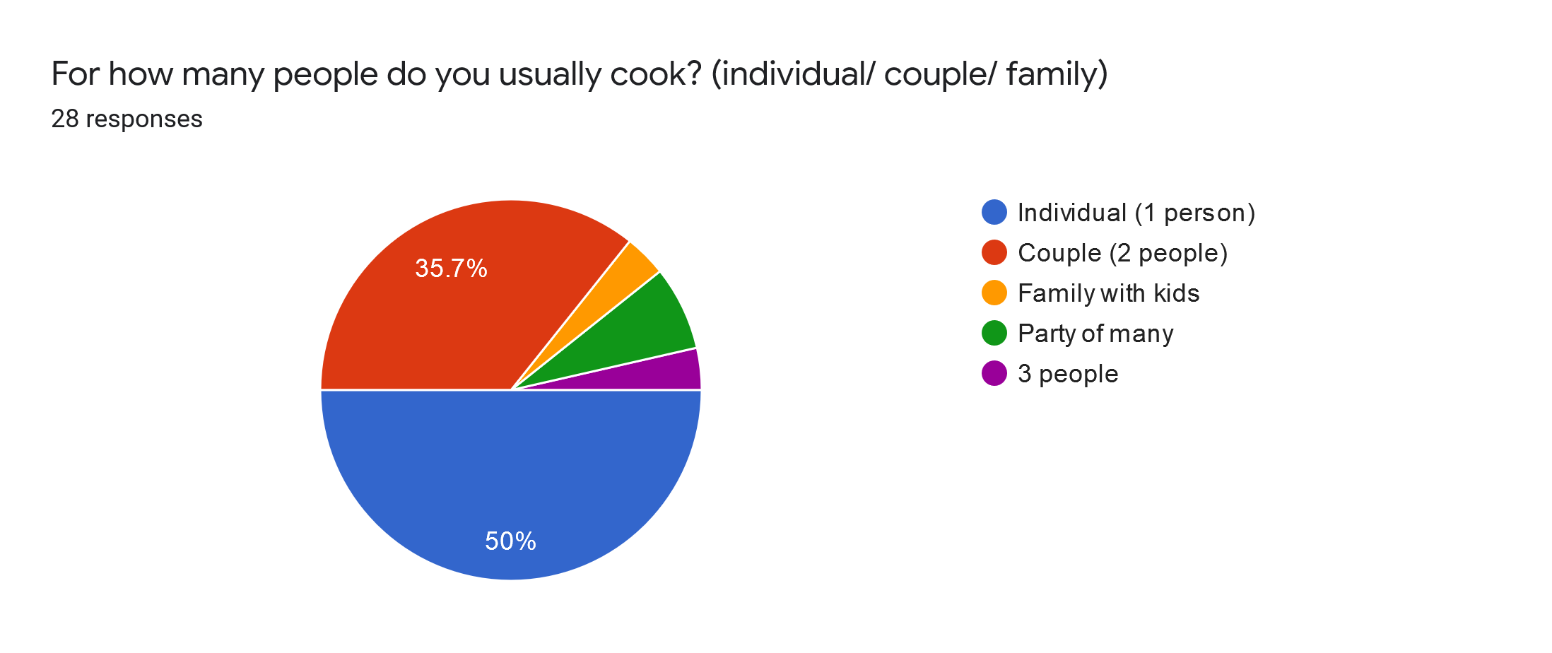
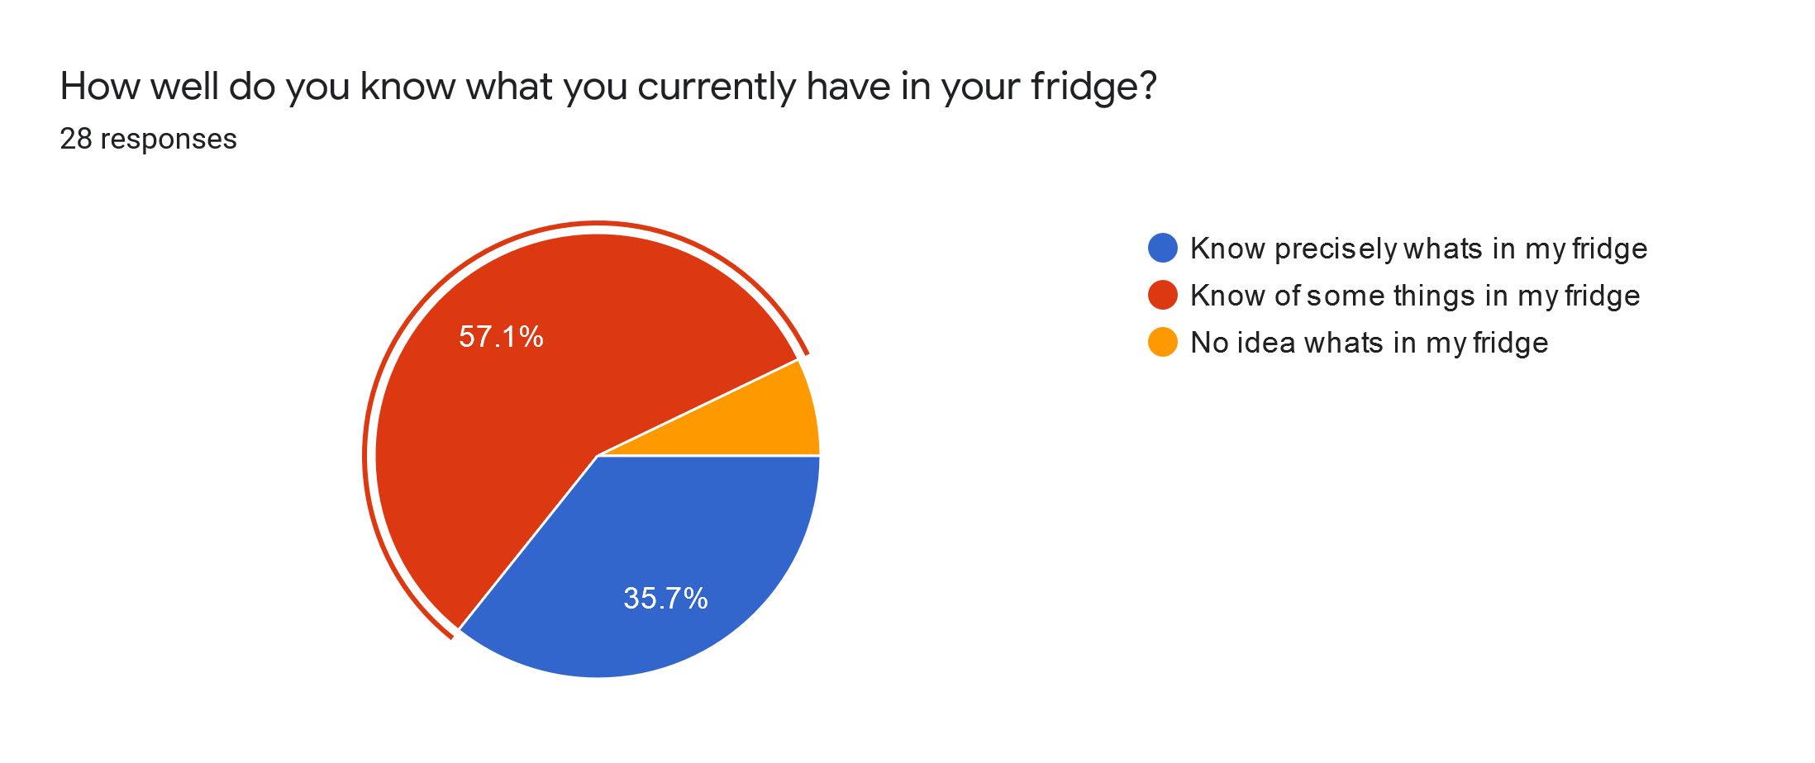
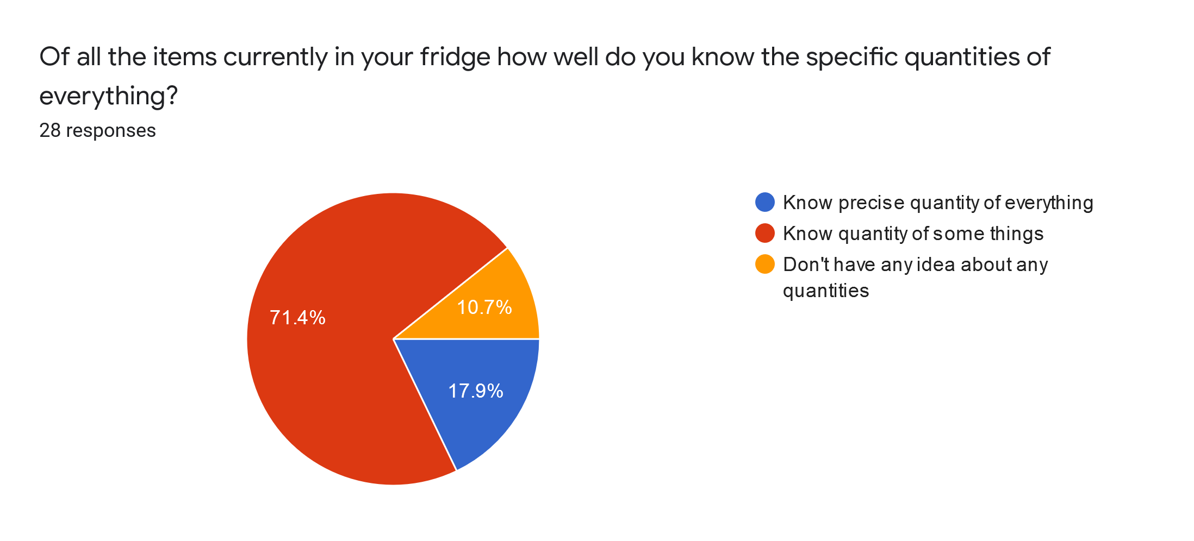
Survey data

Slide 15
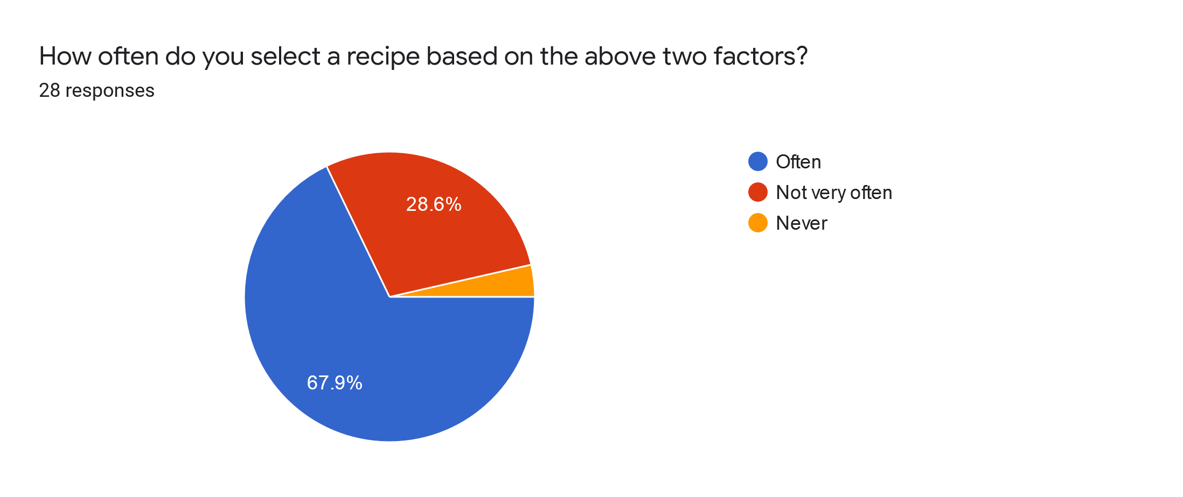
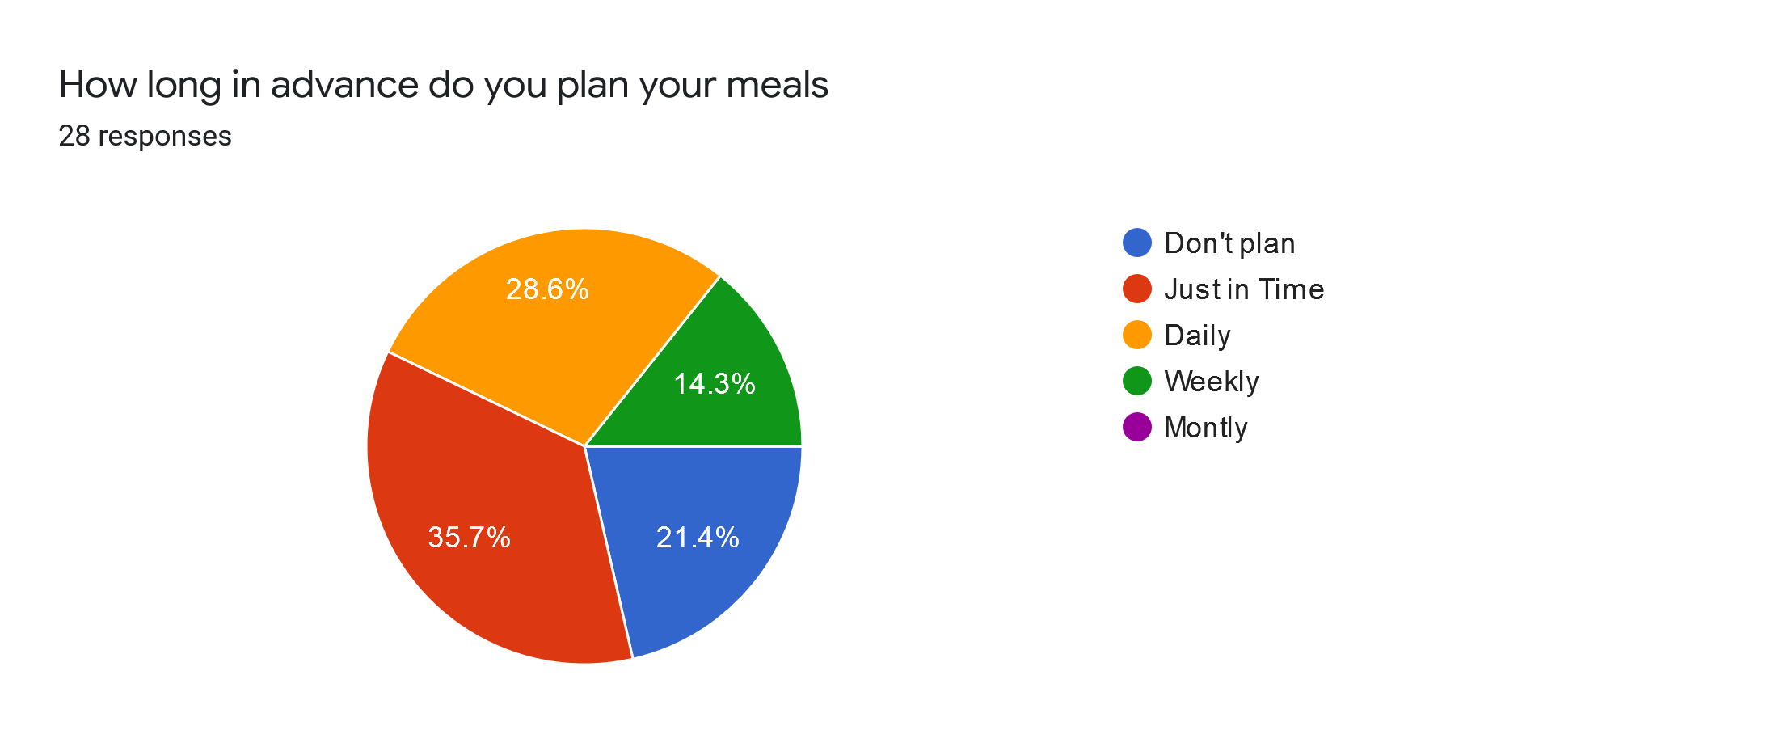
Survey data continued

